Slide 1
US Federal Government
Accessions & Separations
Jade Pierce
Data 601
10/16/23

Slide 2
US Federal Government
Accessions & Separations Data Source
https://www.opm.gov/data/datasets/Index.aspx?tag=FedScope
OPM raw data sets include Accessions & Separations from 2005 to May 2023
The data is obtained from Enterprise Human Resources Integration-Statistical Data Mart. The data does not include data from Intelligence Community agencies, Foreign Service personnel at the State Department, US Postal service, Office of the Vice President and Office of the President. The data also excludes non-appropriated fund employees
Possible errors may be caused from the data being collected by each individual agency and their unique systems. However OPM does validity and relationship checks on the submitted data

Slide 3
US Federal Government
Accessions & Separations Questions
Why are people leaving the federal government? Is it mostly people retiring?
What departments are losing the most people? Are they also the ones hiring the most?
What Agencies are hiring the most people?
What Occupational Category Codes are hiring?
What are the ages that people are being hired on at?
How much experience do new/leaving employees have?
Once hired, how long do people stay?

Slide 4
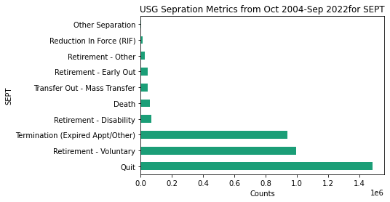
Why are people leaving the federal government? Is it mostly people retiring?

Slide 5
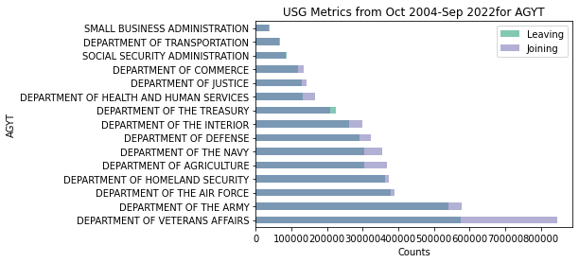
What Departments are losing the most people? Are they also the ones hiring the most?

Slide 6
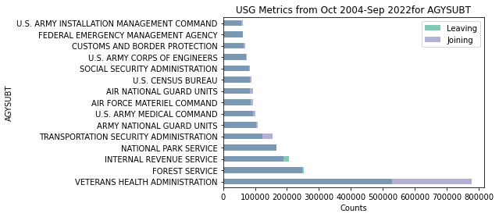
What Agencies are losing the most people?
Are they also the ones hiring the most?

Slide 7
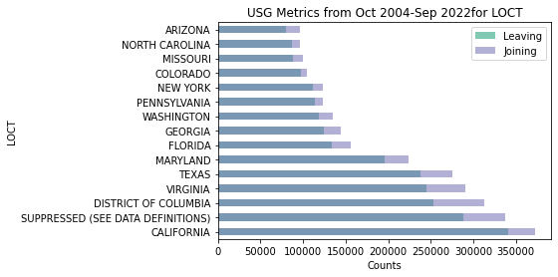
Where are they hiring?
Where are they losing people?

Slide 8
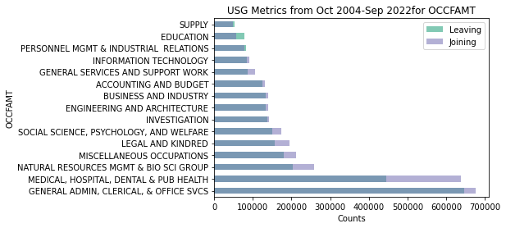
What Occupation Categories hiring?
What Occupation Categories are losing the most?

Slide 9
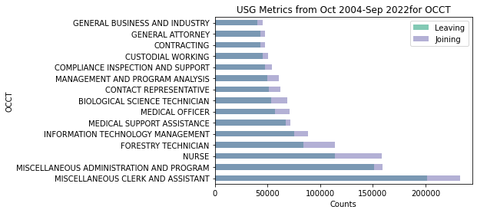
What Specific Occupations hiring the most?

Slide 10
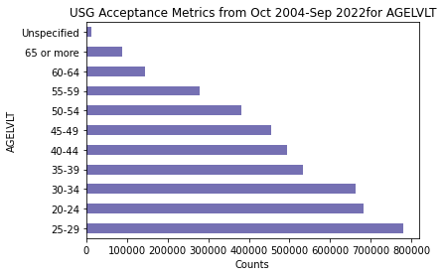
What ages are they hiring?

Slide 11
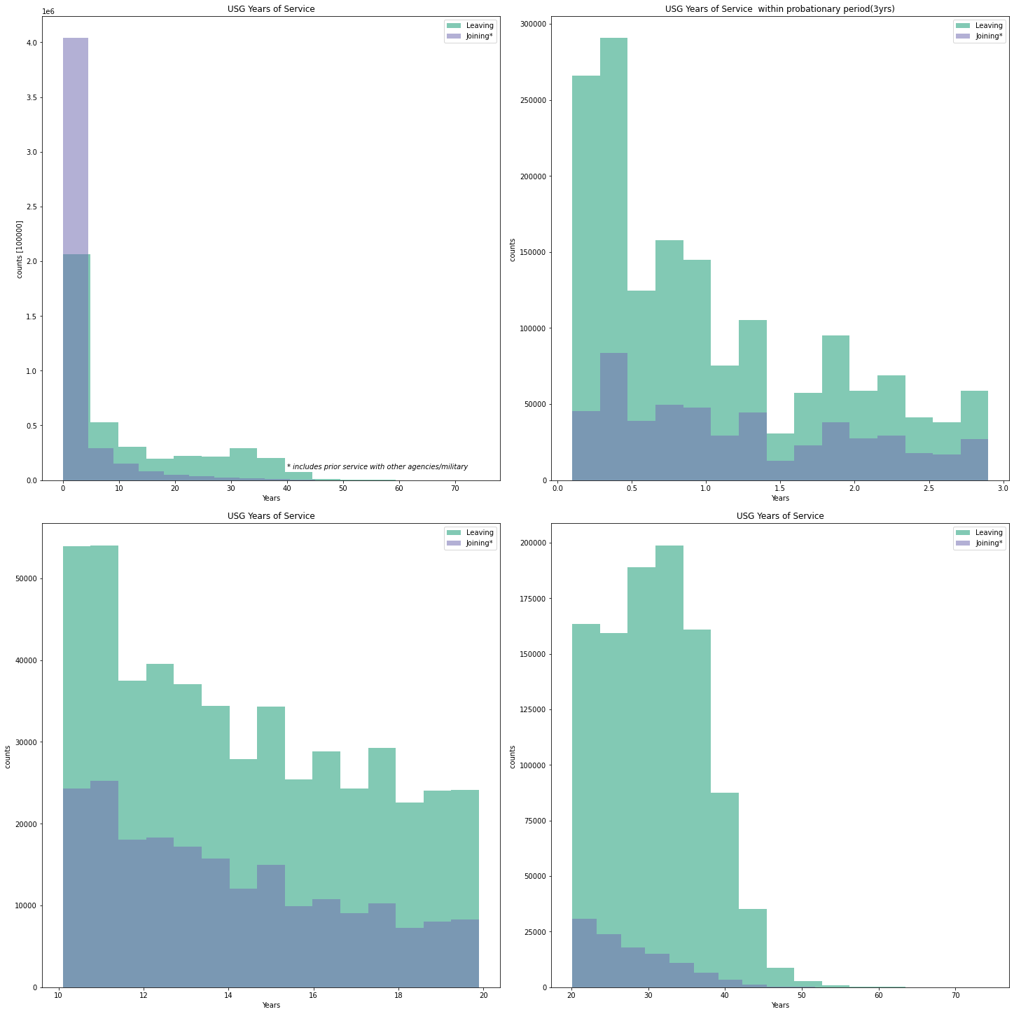
How many years experience in the USG/Mil do people joining or leaving have?
Are people in their probationary period of 3 years likely to leave?

Slide 12
Apply at usajobs.gov

